Slide 1
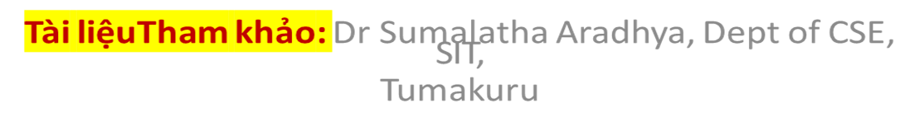
Tiếp theo Chương 2 - phần 2.5_3

Slide 2
Django Framework
What is Django?
Django is a open source web application framework for developing web applications in Python
What is web application framework?
Web application framework is a collection of solutions, packages and best practices
that allows development of web applications and dynamic websites.
Django Architecture:
Django is based on Model-Template-View architecture
Django provides separation of the data model from business rules and the user interface
Django provides a unified API to a database backend
Web application built with Django can work with different databases without requiring any code changes
With the web application design combined with powerful capabilities of Python language And Python ecosystem => Django best suited for IoT applications.
Django consists of an object-relational mapper, a web templating system and regular expression
based URL dispatcher
2

Slide 3


Django Framework
Django Architecture (contd.. From previous slide):
Django is based on Model-Template-View architecture
Model:
Template:
View:
Acts as a definition of some stored data
It handles interactions with the database.
In Web Application, the data can be stored in a relational database, non relational database, an XML file etc.
A Django model is a Python class that outlines the variables and methods for a particular type of data.
The Template is simply an HTML page with a few extra placeholders.
The View ties the model to the template.
The view is where you write the code that actually generates the web pages
View determines what data is to be displayed, retrieves the data from
the database and passes
Django’stemplate language can be used to create various forms of text files(XML, email, CSS, Javascript, CSV etc.)
the data to the template
4

Slide 4
Django Framework
Starting Development with Django:
Follow the links given below, for setting up Django:
Preferred:
https://realpython.com/django-setup/
https://docs.djangoproject.com/en/3.0/topics/install/
https://medium.com/analytics-vidhya/django-rest-api-with-json-web-token- jwt-authentication-69536c01ee18
Others:
https://github.com/Huachao/azure-content/blob/master/articles/virtual- machines/virtual-machines-python-django-web-app-linux.md
https://azure.microsoft.com/en-in/blog/using-django-python-and-mysql-on- windows-azure-web-sites-creating-a-blog-application/
https://azure.microsoft.com/en-in/resources/templates/django-app/
https://docs.djangoproject.com/en/3.0/intro/tutorial01/
4

Slide 5


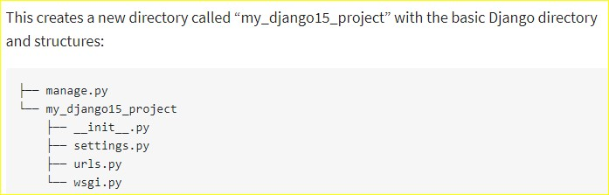
Django Framework
Starting Development with Django:
Creating a Django Project and App:
When you create a new Django project, a number of files are created as shown below:
-Django project can have multiple applications.
-Apps are where you write the code that makes your website function.
-Each project have multiple apps and each app can be part of multiple projects
5

Slide 6

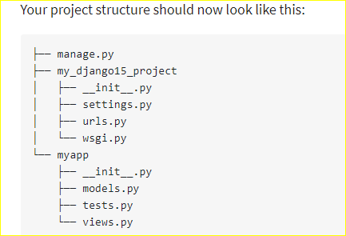
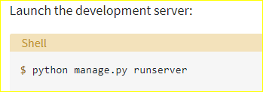
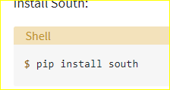
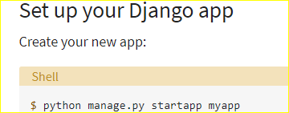
Django Framework :Starting Development with Django
Creating a Django Project and App:
When a new application is created a new directory for the application is also created which
has a number of files such as,
 |  | 1
Django uses 8000 by default. To view the project, do or 2
 | http://localhost:8000
6

Slide 7
Django Framework :Starting Development with Django
Configuring a Database:
Most web applications have a database backend.
Developers have a wide choice of databases that can be used for web applications including both relational and non-relational databases.
Django provides a unified API for database backbends thus giving the freedom to choose the database.
Django supports various relational database engines including MySQL, PostgreSQL, Oracle and SQLite3
Django supports non relational databases such as MongoDB. MongoDBcan be added by installing additional engines
7

Slide 8


Django Framework :Starting Development with Django
Setting up MySQL database:
example
References: https://dev.mysql.com/doc/workbench/en/wb-getting-started-tutorial-create-connection.html https://medium.com/@sostomc011/https-medium-com-sostomc011-getting-started-with-django-mysql-and-react-js-backend- b962a7691486
8

Slide 9
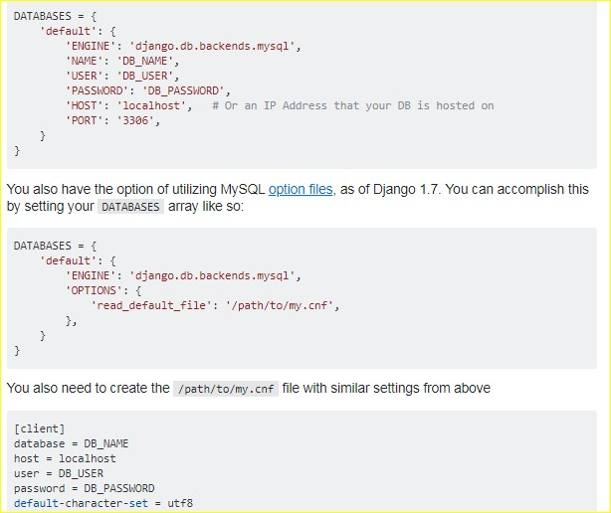
Django Framework :Starting Development with Django
Configuring MySQL database with Django – settings.py
@DATABASE
dictionary
https://stackoverflow.com/questions/19189813/setting-django-up-to-use-mysql

Slide 10
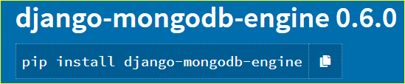
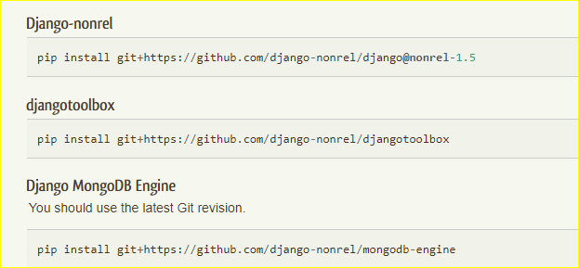
Django Framework :Starting Development with Django
Setting up MongoDB and Django-MongoDB engine
https://pypi.org/project/django-mongodb-engine/
https://django-mongodb-engine.readthedocs.io/en/latest/
https://django-mongodb-engine.readthedocs.io/en/latest/tutorial.html

Slide 11
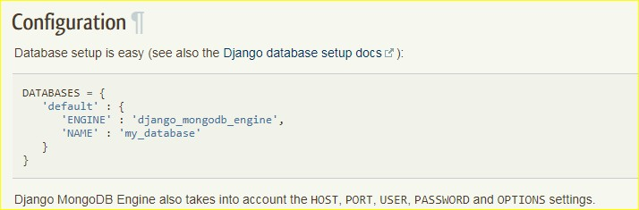
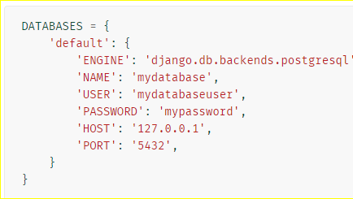
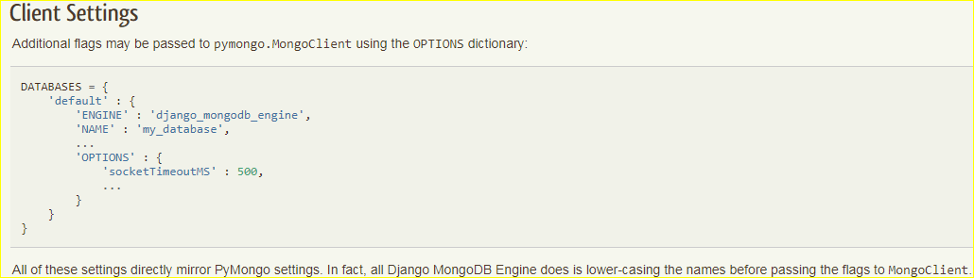
Django Framework :Starting Development with Django
Configuring MongoDB with Django- settings.py
For postGreSql DB
https://pypi.org/project/django-mongodb-engine/
12
https://docs.djangoproject.com/en/dev/ref/settings/#databases

Slide 12
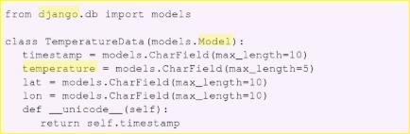
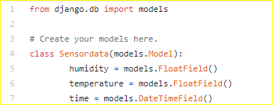
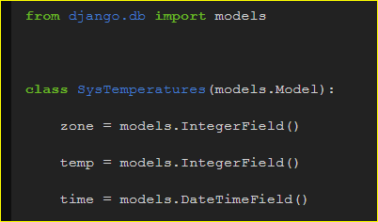
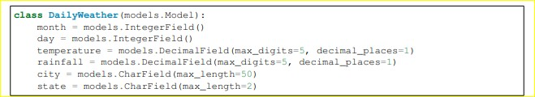

Django Framework :Starting Development with Django
Defining a Model:
Model acts as a definition of the data in the database
Examples:
Each class that represents
database table is a subclass of
django.db.models.model
1
2
https://github.com/Oskube/django-dht22/blob/master/dht22/models.py
https://thedig95.github.io/2018/09/08/data-api.html
3
To sync the model with the atabase,
run the following command:
when syncdb command is run for the first time, it creates all the tables defined in the Django model in the configured database.
13
https://readthedocs.org/projects/django-chartit/downloads/pdf/latest/
4
References: https://github.com/Oskube/django-dht22
https://riptutorial.com/django/example/12704/number-fields

Slide 13


Django Framework :Starting Development with Django
Django Admin site:
Django provides an administration system that allows to manage the website without writing additional code.
“admin” system reads the Django model and provides an interface that can be used to add content to site
The Django admin site is enabled by adding django.contrib.admin and
django.contrib.admindocs to the INSTALLED_APPS section in the settings.py file
The admin site requires URL pattern definitions in the urls.py
To define the editable application models in the admin interface, a new file named admin.py
is to be created.
Enabling admin for Django Models
14
https://www.geeksforgeeks.org/weather-app-using-django-python/

Slide 14
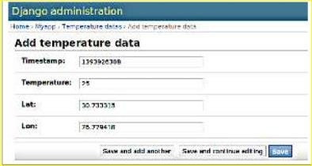
Django Framework :Starting Development with Django
Django Admin site:
Adding new items in the temperature data table using admin site:
Reference: https://djangobook.com/mdj2-django-admin/ https://docs.djangoproject.com/en/dev/ref/contrib/admin/#modeladmin-objects

Slide 15
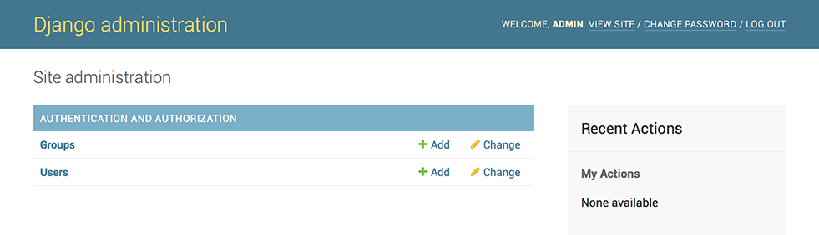
Django Framework :Starting Development with Django
Django Admin site:
Adding new items in the data table using admin site:
Reference: https://djangobook.com/mdj2-django-admin/ https://docs.djangoproject.com/en/3.0/intro/tutorial02/
https://data-flair.training/blogs/django-admin-interface/

Slide 16
Django Framework :Starting Development with Django
Defining a View:
The view contains the logic that glues the model to the template.
The view determines the data to be displayed in the template, retrieves the data from the Database and passes it to the template
The view also extracts the data posted in a form in the template and inserts it in the
database
Each page in the website has a separate view, and is basically a Python function in the views.py file
Views can also perform additional tasks such as authentication, sending emails etc.

Slide 17
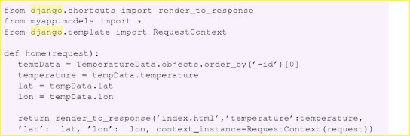
Django Framework :Starting Development with Django
Defining a Django View:
This view corresponds to the webpage that displays latest entry in the TemperatureData table.
In this view, the Django’s built in object- relational mapping API is used to retrieve the data from the TemperatureData table
Example #1:
Returns latest entry in the
To retrive all entries, use,
table.objects.all()
To fliter out queries, use,
table.objects.fliter(**kwargs)
table
Used to render the retrieved entries in the template
It
returns HttpResp onse object
1
The object relational mapping API allows the developers to write generic code for
interacting with data base without worrying about underlying database engine

Slide 18
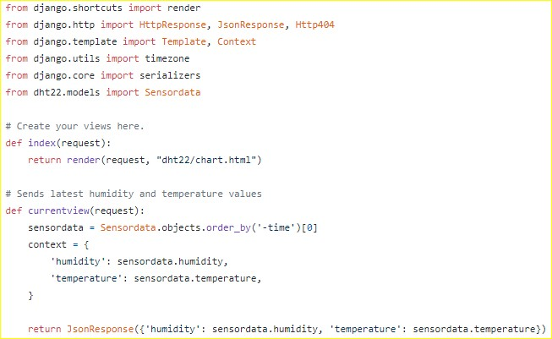
Django Framework :Starting Development with Django
Defining a Django View:
Example #2:
2
1

Slide 19
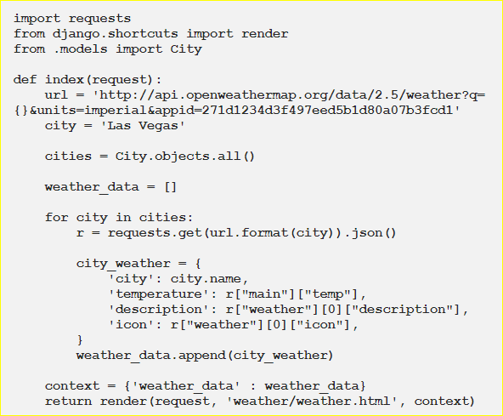
Django Framework :Starting Development with Django
Defining a Django View:
Example #3:
1
3
20
Reference: https://medium.com/analytics-vidhya/make-a-weather-application-using-django-a9a131e3bae7

Slide 20
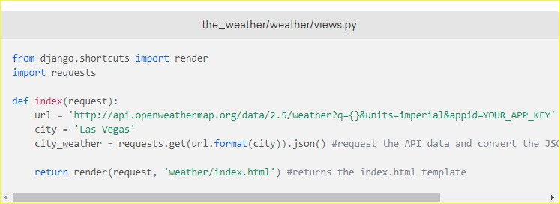
Django Framework :Starting Development with Django
Defining a Django View:
Example #4:
1
4
Reference: https://www.digitalocean.com/community/tutorials/how-to-build-a-weather-app-in-django

Slide 21
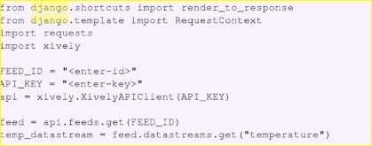
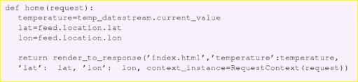
Django Framework :Starting Development with Django
Defining an alternative Django View that retrieves data from Xively cloud
1

Slide 22
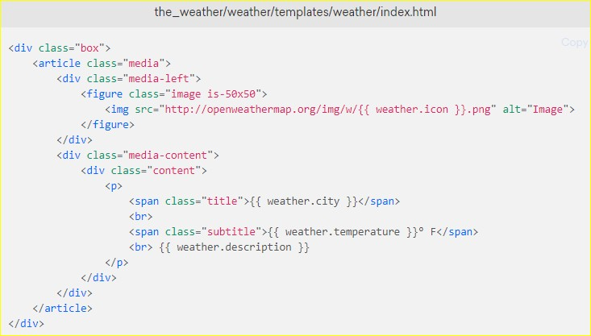
Django Framework :Starting Development with Django
Defining a Django Template:
A Django template is typically an HTML file
Django template allow separation of the presentation of data from the actual data using
placeholder and associated logic(using template tags)
A template receives a context from the view and presents the data in context variables in the placeholders.
Example #1:

Slide 23
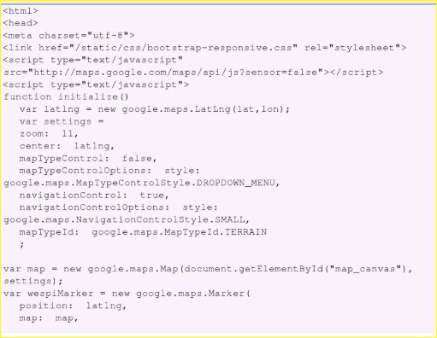
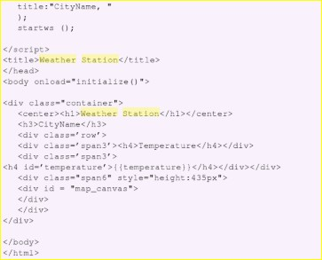
Django Framework :Starting Development with Django
Defining a Django Template:
Example #2- A template for the weather station app
1
2

Slide 24
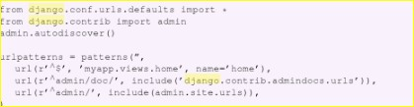
Django Framework :Starting Development with Django
Defining the Django URL patterns:
URL patterns are a way of mapping the URLs to the views that should handle the URL requests
URLs requested by the user are matched with the URL patterns
The view corresponding to the pattern matches the URL is used to handle the request.
Example of URL configuration:
1

Slide 25
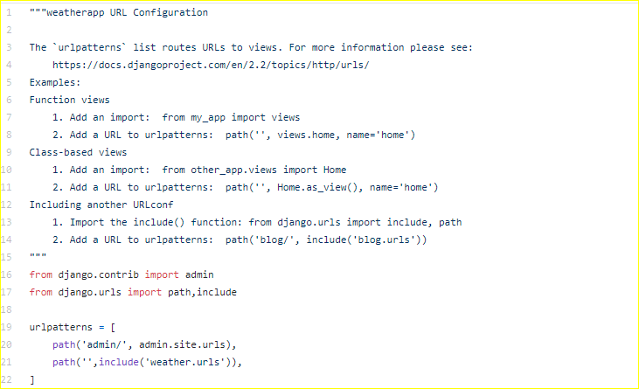
Django Framework :Starting Development with Django
Defining the Django URL patterns:
Example of URL configuration:
2
Reference: https://github.com/localhostfotly/django-weather-app/blob/master/weatherapp/urls.py

Slide 26
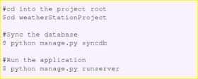
^{Django Framework :}Running a Django Application
With the Django Models, Views, Templates and URLs defined for the Django project, the application will finally run with commands as shown below:

Slide 27
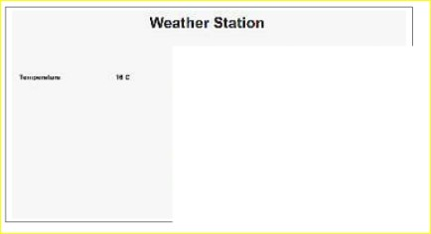
Django Framework :Starting Development with Django
the weather station app Screen shot:

Slide 28


